Slide 1
Introduction to computer studies(ICS)

Slide 2
Robotics
Robots are the future

Slide 3
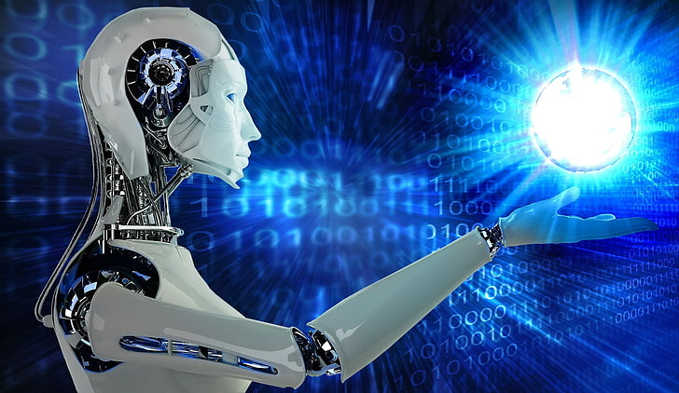
Introduction

Slide 4
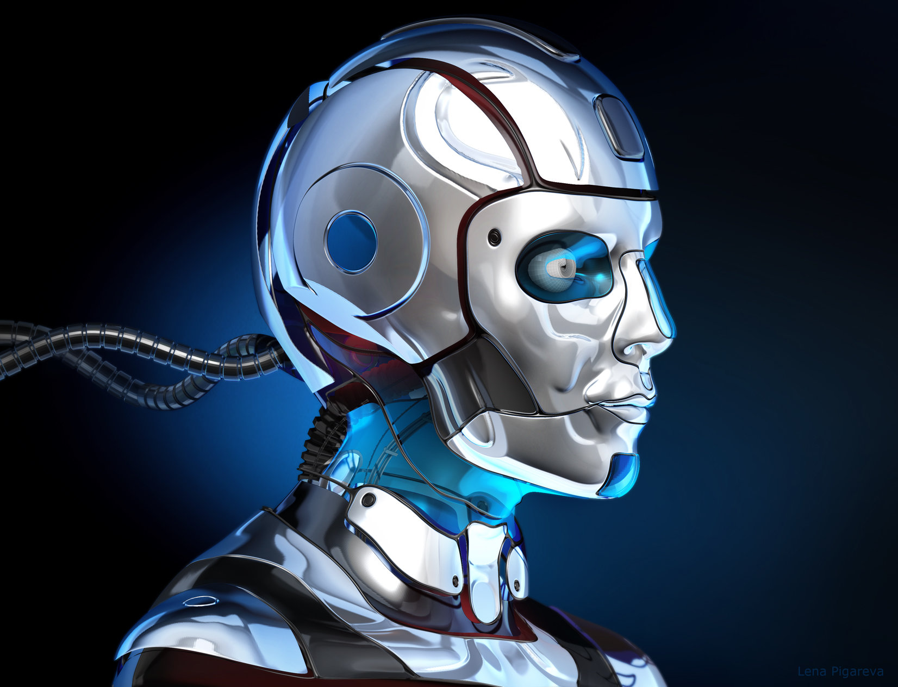
∙ Comes form Slavic word- Robota
∙ Branch of technology
∙ Deals with automated machines

Slide 5
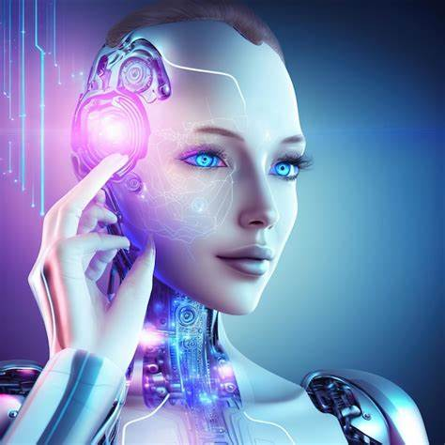
ROBOTS AND THEIR MECHANISM

Slide 6
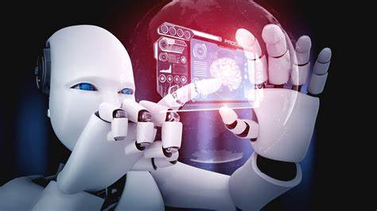
∙ Can be of different shape and size
Physical and mental works
∙ Programmable by a computer

Slide 7
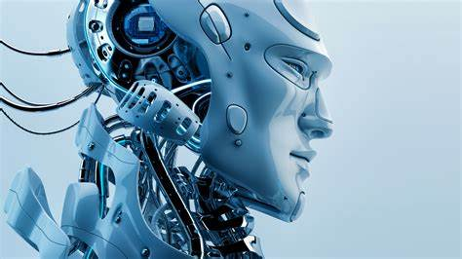
MECHANISM
Multi-body system
∙ Rigid body called a link

Slide 8
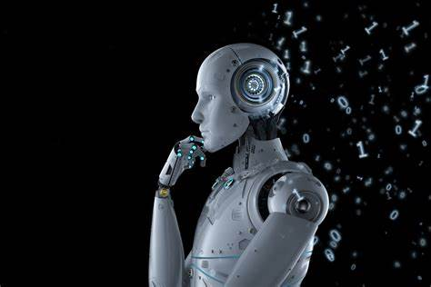
:-
*ASIMO
From Honda,
AIBO
From Sony and
Lynx Robot
From UBTech
*Murata Boy
From Murata Manufacturing,
Robots of Different companies

Slide 9
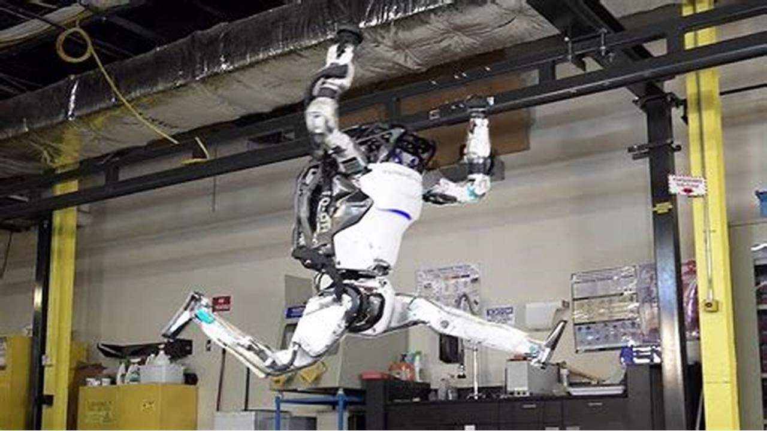
Characteristics

Slide 10
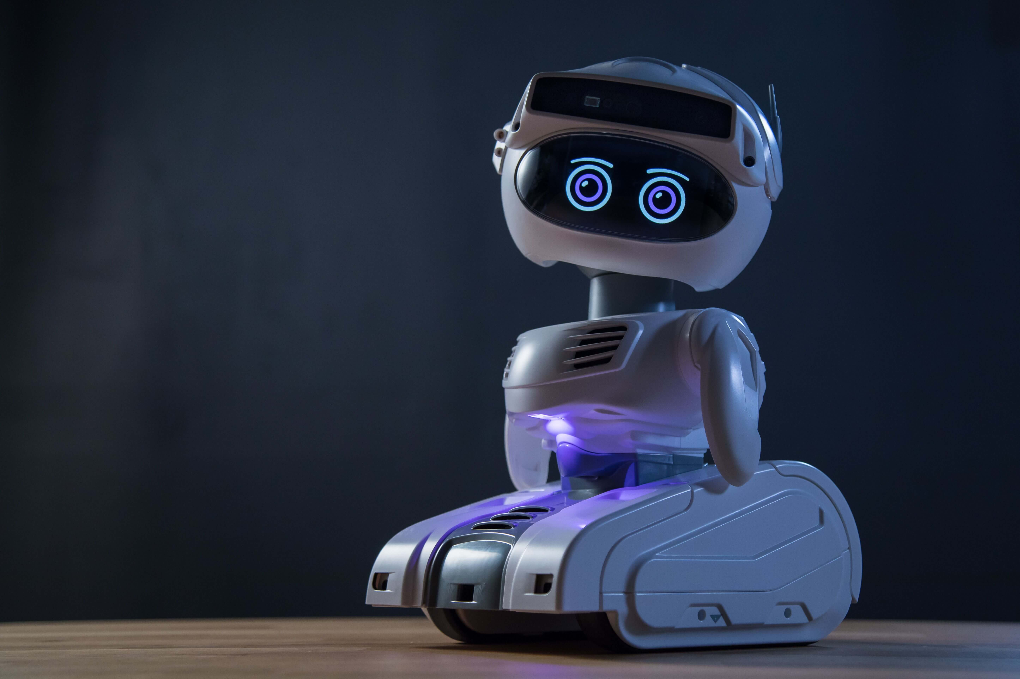
Sensing
Movement
Energy
Intelligence

Slide 11
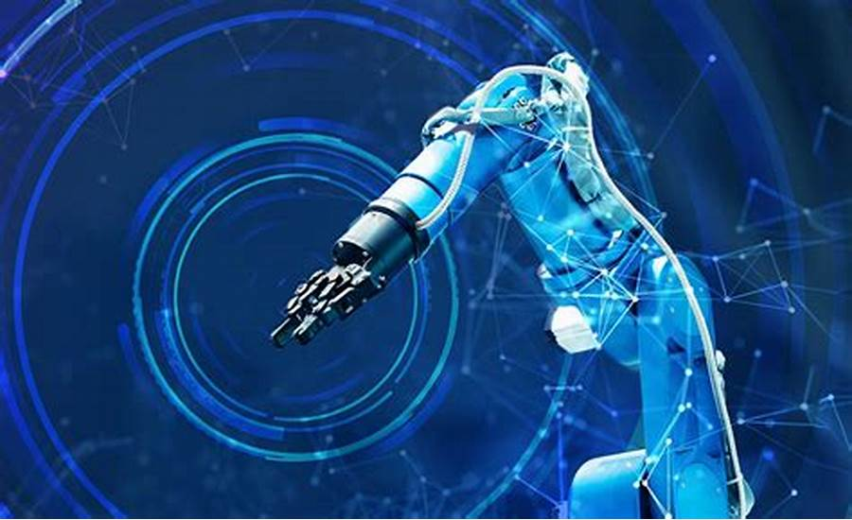
Parts

Slide 12
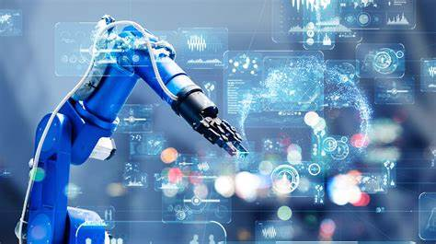
Parts of Robot
End Effector
Controller
Arm
Drive
Sensor

Slide 13
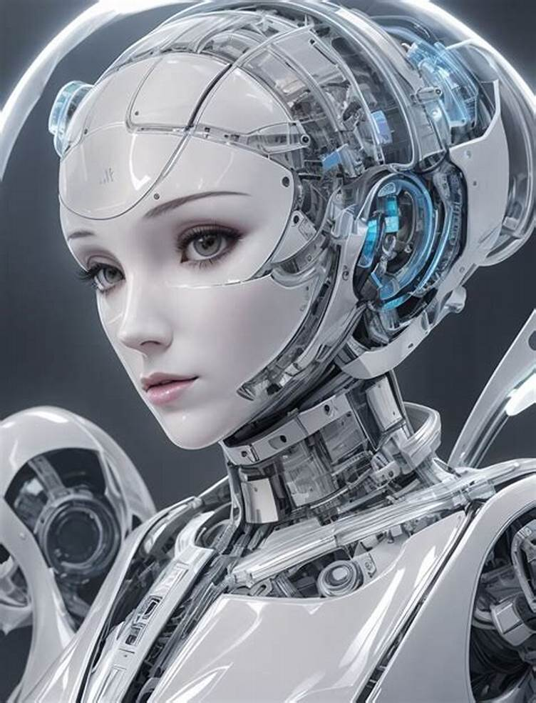
Features
*Security Purpose
*Management of Works
*Voice Recognition

Slide 14
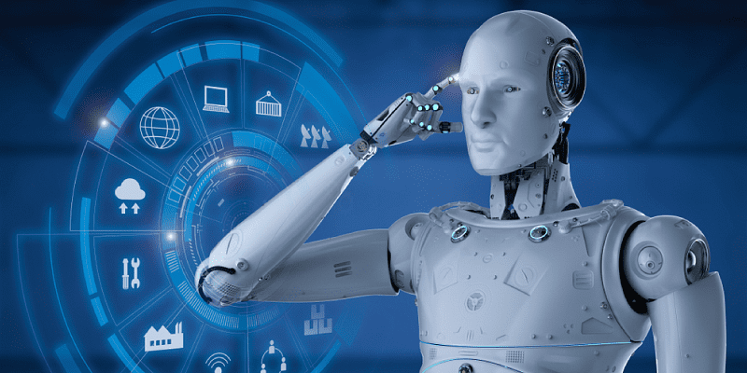
ADVANTAGES

Slide 15
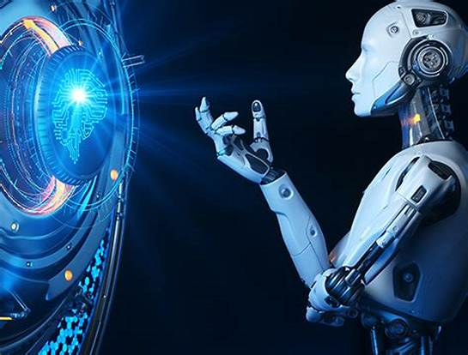
Increased efficiency
Higher quality
Longer working hours
Increased profitability

Slide 16
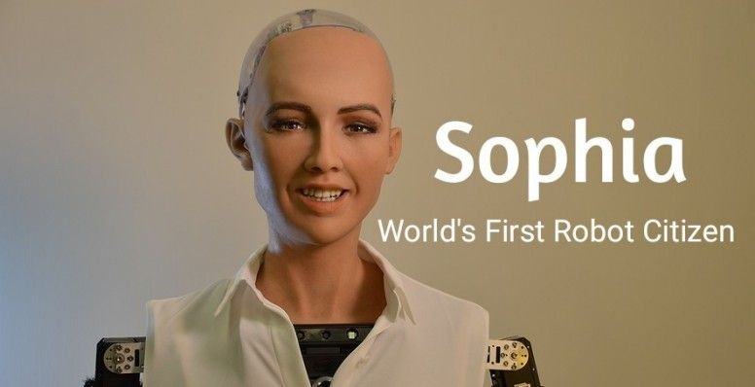
SOPHIA The humanoid robot

Slide 17
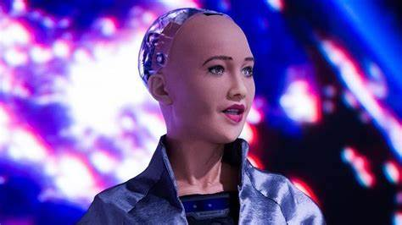
SOPHIA
∙ On 6 December, 2017
∙ First social Robot

Slide 18
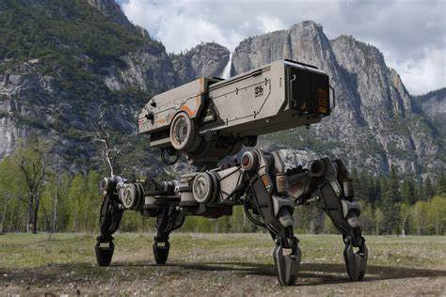
Uses of Robots

Slide 19
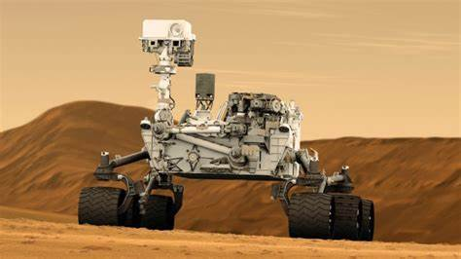
∙ Lift and move.
∙ In space exploration
∙ Extraction from mines.

Slide 20
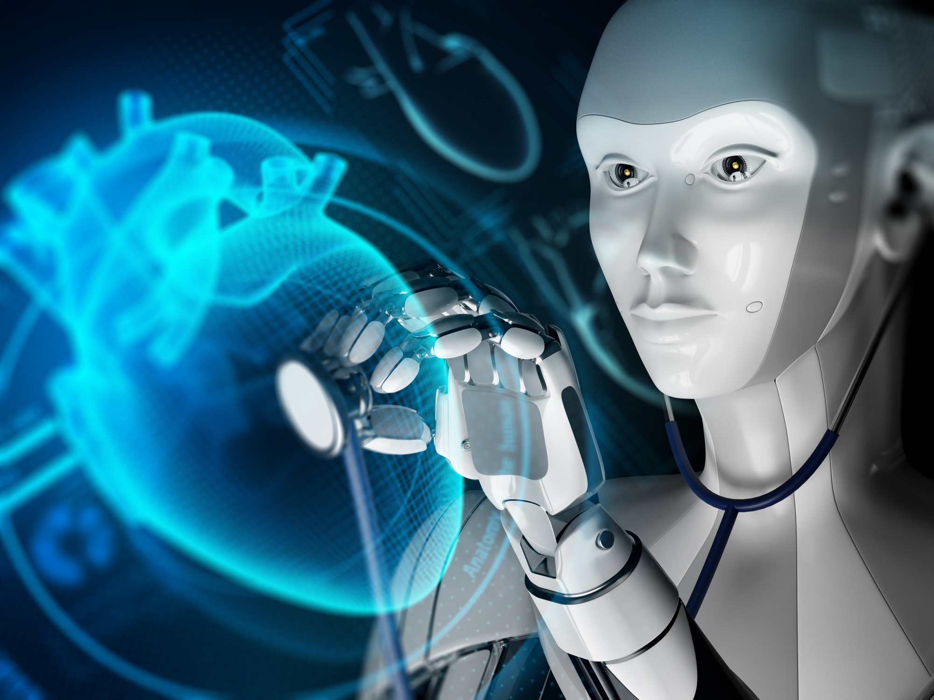
∙ Medical surgeries.

Slide 21
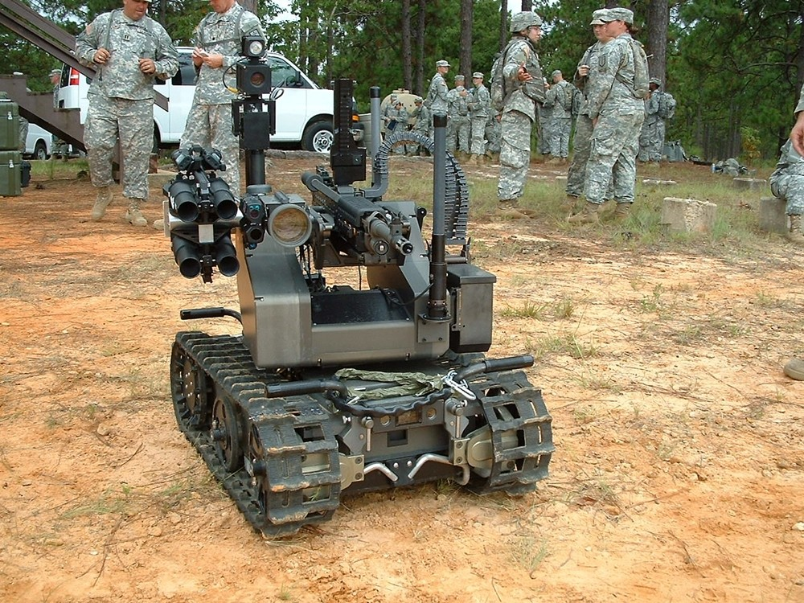
Military Works

Slide 22
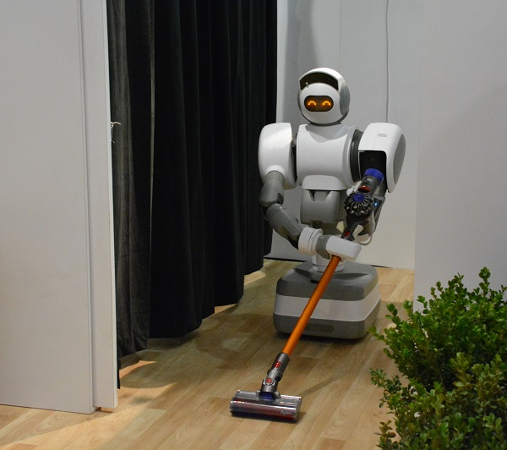
In Household works

Slide 23
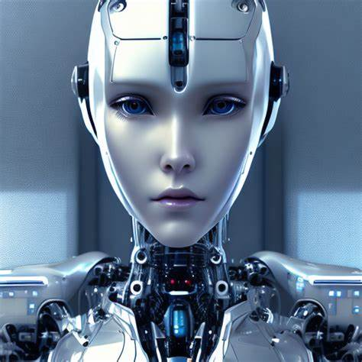
Abuses of Robots

Slide 24

∙ Costly
∙ Unemployment

Slide 25
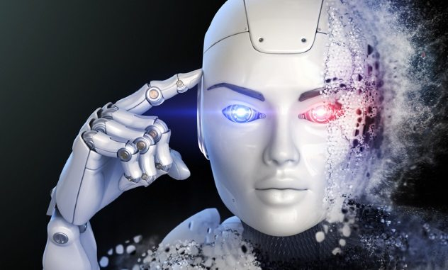
∙ Dangerous

Slide 26
Thank You

